Slide 1
CONVOLUTIONAL NEURAL NETWORKS
- ASSIGNMENT 03
PAVITRA ANKESH
CSE- 5D
ENG19CS0221
Google Colab Link:
https://colab.research.google.com/drive/10N_xNIpAo3kUseauqL8R7DZ-J26oQ4yM?usp=sharing

Slide 2
CONTENTS
Deep Neural Networks
Types of Deep Neural Network
Recurrent Neural Network
Generative Adversarial Networks
Convolutional Neural Network
Implementation of CNN

Slide 3
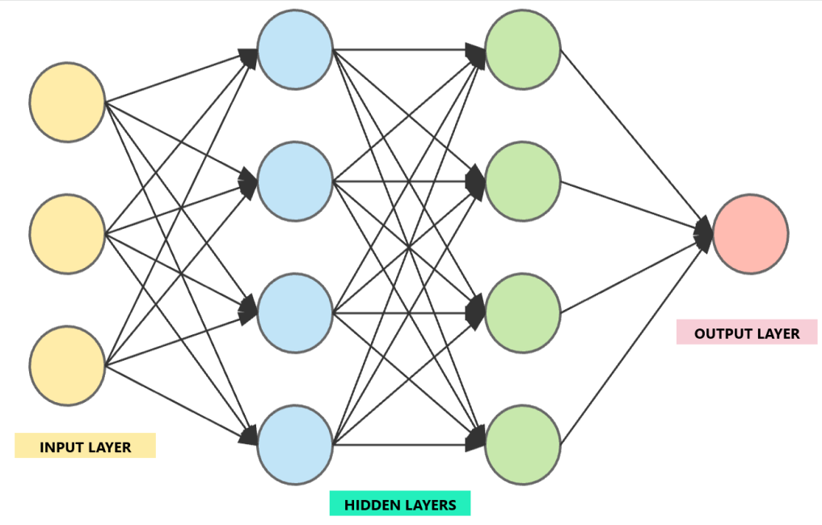
DEEP NEURAL NETWORKS
A deep neural network (DNN) is an artificial neural network with an input layer, multiple hidden layers and an output layer.
Input Layer:
The input layer takes large volumes of data as input.
Hidden Layers:
The hidden layer processes the input data and
carries out feature extraction. Each layer has
weights and biases of inputs which can be updated.
Output Layer:
The output layer generates the required output.

Slide 4
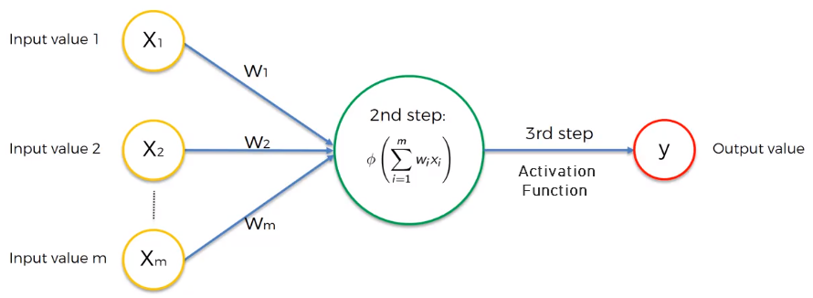
DEEP NEURAL NETWORKS
In a deep neural network, each input signal is assigned a weight. This weight is multiplied by the input value and the neuron stores the weighted sum of all the input variables. An activation function is then applied to the weighted sum, which results in the output signal of the neuron.

Slide 5
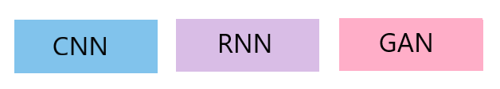
TYPES OF DEEP NEURAL NETWORKS
Three following types of deep neural networks are popularly used today:
Recurrent Neural Network (RNN)
Generative Adversarial Networks (GAN)
Convolutional Neural Network (CNN)

Slide 6
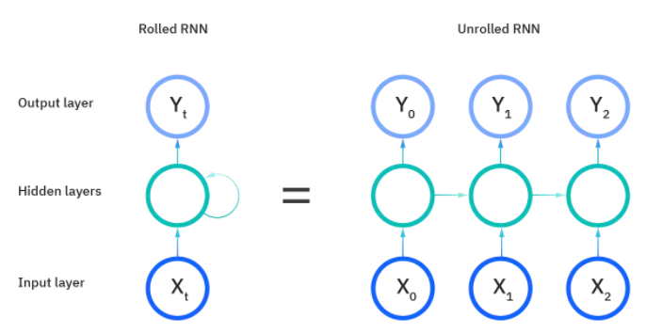
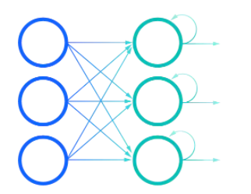
RECURRENT NEURAL NETWORK (RNN)
Recurrent Neural Networks (RNN) are a type of neural networks that are mostly used for sequential data. In a RNN the information cycles through a loop. It makes the use of an internal memory such that it considers the current input as well as the output from the previous inputs in order to obtain the predicted output in the sequence.

Slide 7
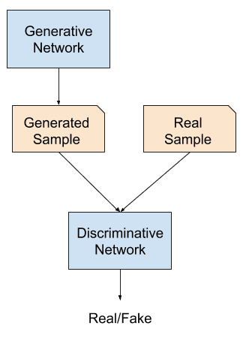
GENERATIVE ADVERSARIAL NETWORKS (GAN)
Generative Adversarial Networks (GAN) are a deep learning based generative model. The GAN model architecture involves two sub-models: a generator model for generating new examples and a discriminator model for classifying whether generated examples are real or fake.

Slide 8
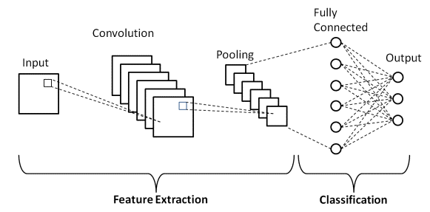
CONVOLUTIONAL NEURAL NETWORK (CNN)
Convolutional Neural Networks or CNNs, are a special kind of neural network for processing data that has a grid-like topology for example, images. The CNN is a combination of two basic building blocks: The Feature Extraction Block that consists of the Convolution Layer and the Pooling Layer. And Classification Block that consists of a fully connected simple neural network architecture.

Slide 9
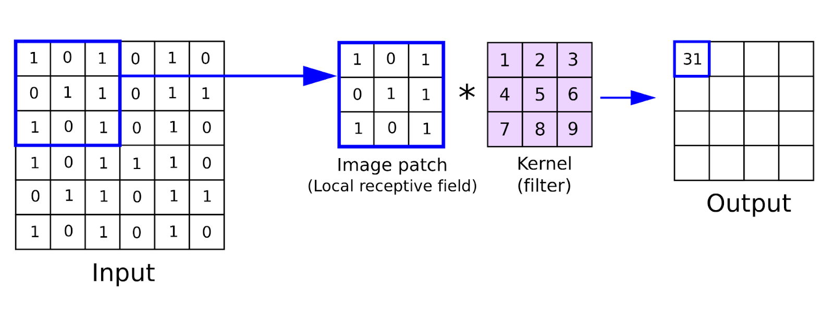
CONVOLUTIONAL NEURAL NETWORK (CNN)
Convolution Layer:
The convolution operation involves multiplying the values of a cell corresponding to a particular row and column, of the image matrix, with the value of the corresponding cell in the filter matrix and adding them together. The RELU or Rectified Linear Unit is applied on all the cells of all the output-matrix.

Slide 10
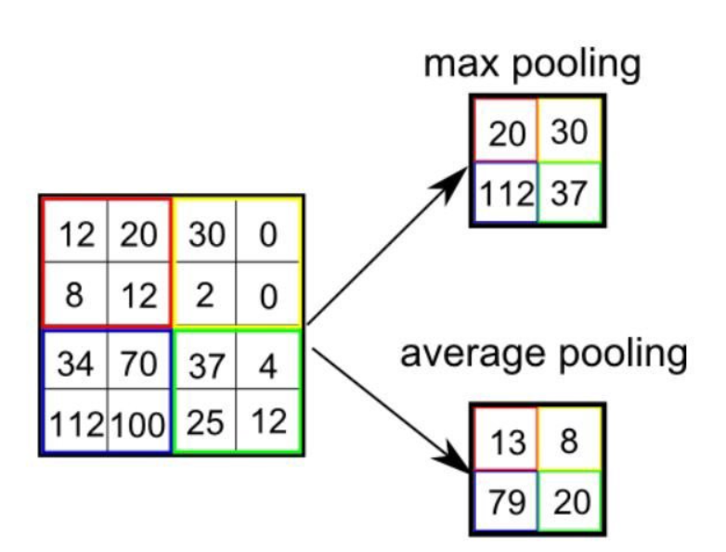
CONVOLUTIONAL NEURAL NETWORK (CNN)
Pooling Layer:
The Pooling layer consist of performing the process of extracting a particular value from a set of values, usually the max value or the average value of all the values. This reduces the size of the output matrix.

Slide 11
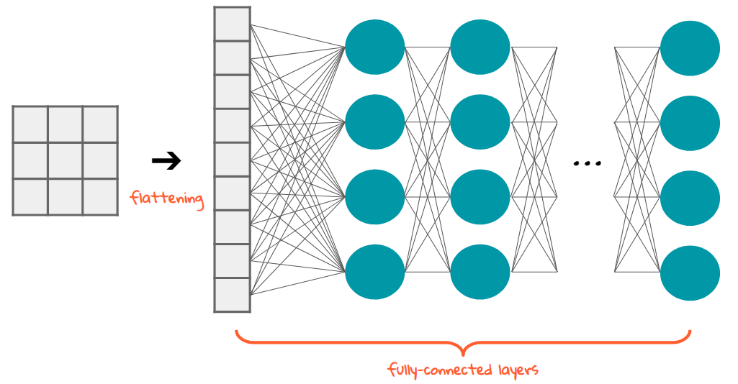
CONVOLUTIONAL NEURAL NETWORK (CNN)
Fully Connected Layer:
The fully connected layer is a Fully connected Simple Neural Network, consisting of two or three hidden layers and an output layer, that performs the work of classification among a large number of categories.

Slide 12
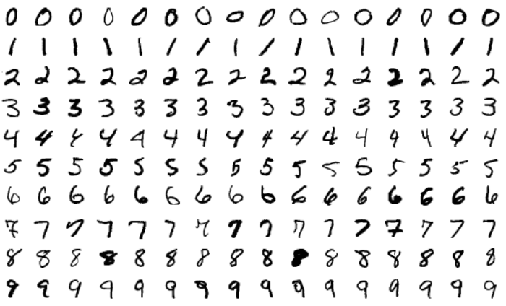
IMPLEMENTATION OF CNN
Classification of Handwritten Digits Using CNN
import tensorflow as tf
from tensorflow.keras import layers,models
from tensorflow import keras
import numpy as np
(X_train, y_train) , (X_test, y_test) = keras.datasets.mnist.load_data()
X_train = X_train / 255
X_test = X_test / 255
X_train = X_train.reshape(-1,28,28,1)
X_test = X_test.reshape(-1,28,28,1)

Slide 13
IMPLEMENTATION OF CNN
Classification of Handwritten Digits Using CNN
cnn = models.Sequential([
layers.Conv2D(filters=25, kernel_size=(3, 3), activation='relu', input_shape=(28,28,1)),
layers.MaxPooling2D((2, 2)),
layers.Conv2D(filters=64, kernel_size=(3, 3), activation='relu'),
layers.MaxPooling2D((2, 2)), layers.Conv2D(filters=64, kernel_size=(3, 3), activation='relu'),
layers.MaxPooling2D((2, 2)),
layers.Flatten(),
layers.Dense(64, activation='relu'),
layers.Dense(10, activation='softmax')
])

Slide 14
IMPLEMENTATION OF CNN
Classification of Handwritten Digits Using CNN
cnn.compile(optimizer='adam', loss='sparse_categorical_crossentropy', metrics=['accuracy'])
cnn.fit(X_train, y_train, epochs=10)
cnn.evaluate(X_test, y_test)
y_predicted_by_model = cnn.predict(X_test)
np.argmax(y_predicted_by_model[0])

Slide 15
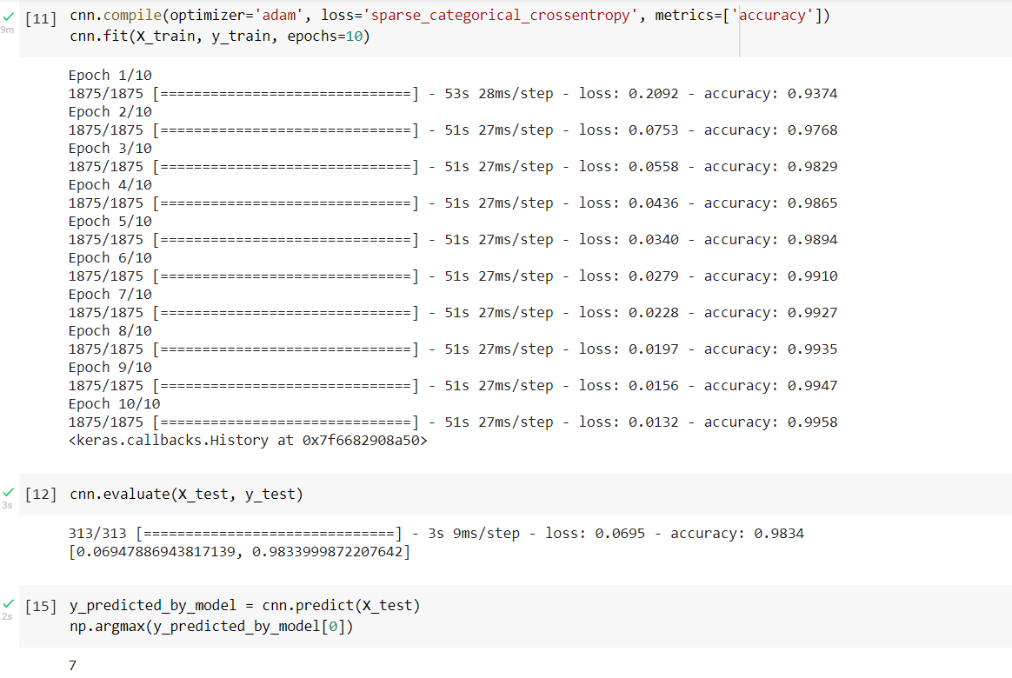
IMPLEMENTATION OF CNN
Classification of Handwritten Digits Using CNN- Output

Slide 16
REFERENCES
https://www.simplilearn.com/tutorials/deep-learning-tutorial/neural-network?source=sl_frs_nav_playlist_video_clicked
https://www.digitalvidya.com/blog/types-of-neural-networks/
https://builtin.com/data-science/recurrent-neural-networks-and-lstm
https://machinelearningmastery.com/what-are-generative-adversarial-networks-gans/
https://medium.com/@himadrisankarchatterjee/a-basic-introduction-to-convolutional-neural-network-8e39019b27c4
https://www.analyticsvidhya.com/blog/2021/07/classification-of-handwritten-digits-using-cnn/

